Slide 1
Correlation between “We The People” and Congress
Tim Blazek, Olivia Roy, Andy Shin
Social Sensing and Cyber-Physical Systems
Spring 2019

Slide 2
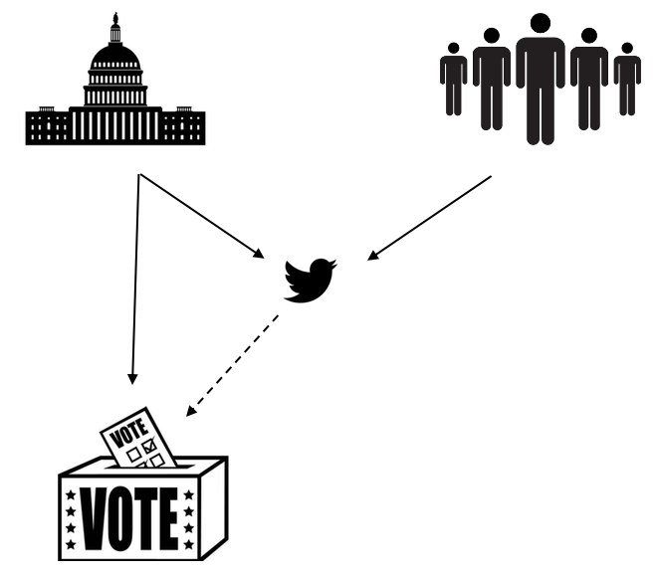
Motivation
Encourage writing and calling to Senators
Tweet political opinions and feelings
Do Senators accurately represent people?
75% of time vote with party

Slide 3
Methods
GetOldTweets library
Tweets @ Senators
How Senators voted
TextBlob for sentiment analysis
Custom Predictor

Slide 4

Methods
GetOldTweets library
Tweets @ Senators
How Senators voted
Complement Naïve Bayes Classifier
Custom Predictor

Slide 5
Progress after Midterm

Slide 6
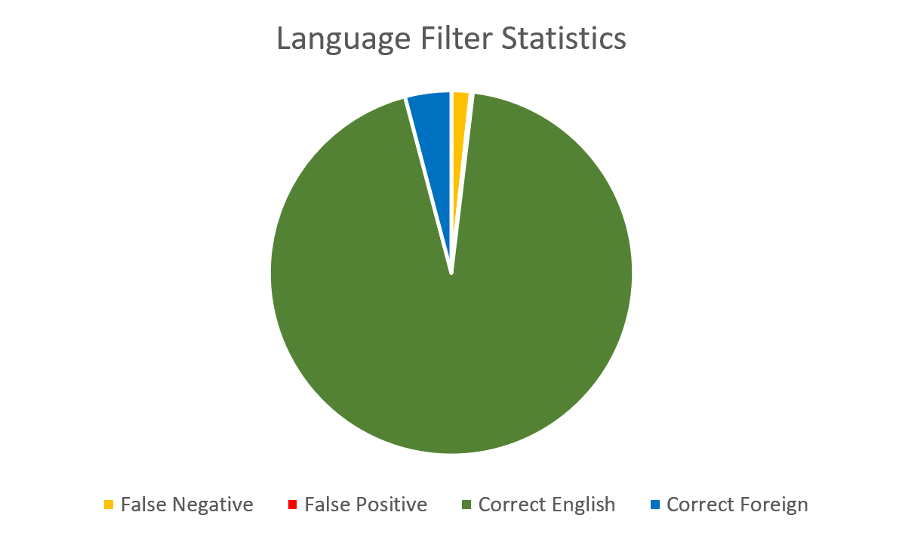
Language Detection
Used langdetect to classify tweets’ language
Used 1000 tweets to measure performance of python package
1.7% false negatives (tended to include links)
0.2% false positives

Slide 7
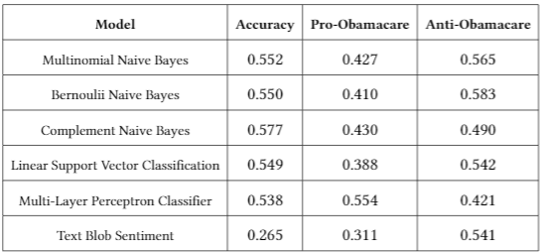
Classifier
Hand classified 600 random Obamacare tweets
Ran the tweets through a tfidf vectorization and simulated it through different sklearn models
Complement Naïve Bayes performed the best

Slide 8
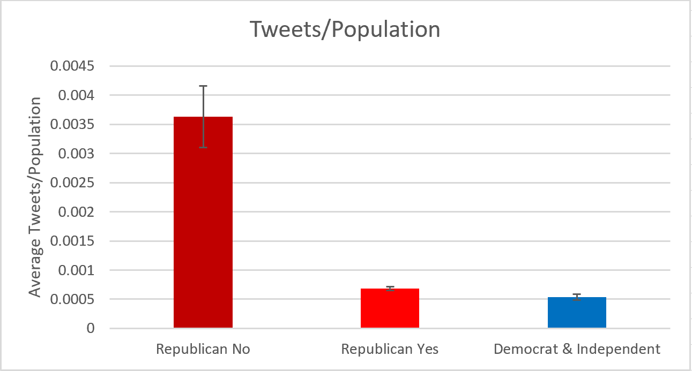
Justifying Population
Republicans that voted against party lines received higher amounts of tweets
Proportion wise, not many people tweet at their senator

Slide 9
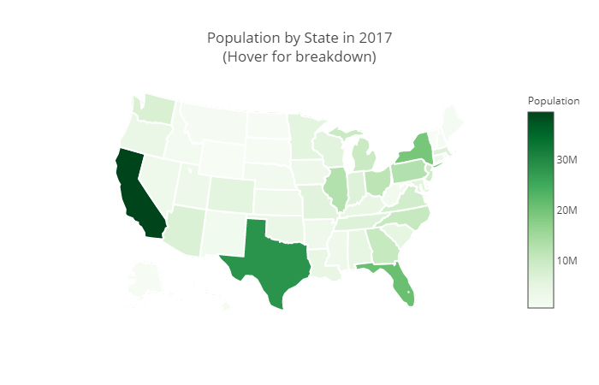
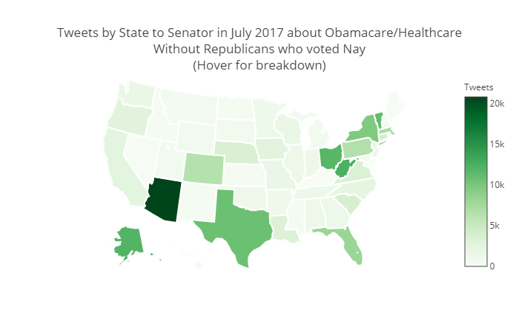
Justifying Population
Mapped number of tweets collected by state senator
Removed senators that voted against party line to eliminate bias

Slide 10
Evaluation Results

Slide 11
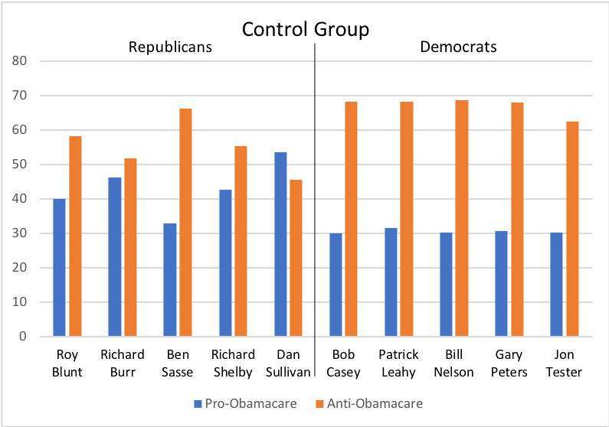
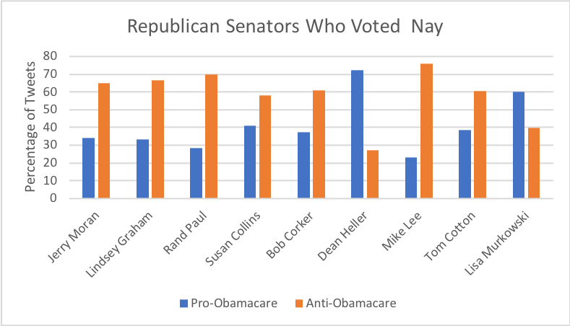
Initial Senators Results

Slide 12
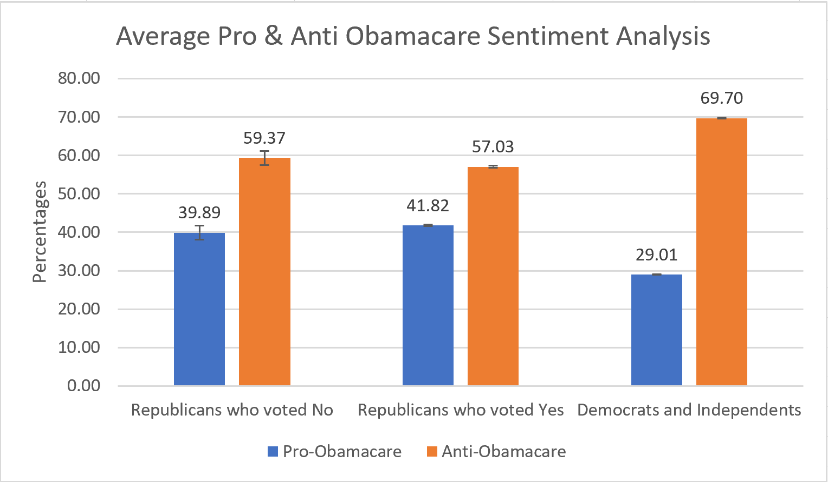
Collective Senators Results
Democrats tended to get higher amounts of anti-Obamacare tweets
Republicans are statistically the same on average

Slide 13
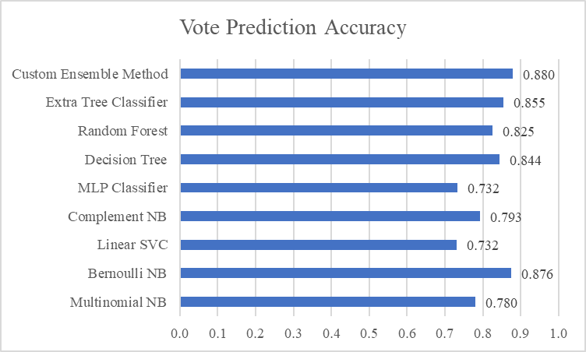
Predictor
Created a predictor to guess how each senator would vote
Our custom ensemble method performed the best amongst all models
Guessed the vote to be 45-55 (while it was 43-57 in reality)

Slide 14
Discussion

Slide 15
Conclusion
Weak correlated between tweets gathered and state population size
Most of the tweets gathered were classified as Anti-Obamacare, especially towards Democrats
People tend to voice their opinion when against something, rather than for something
Senators voting against party line tended to get tweeted at more
Able to predict voting with good accuracy

Slide 16
Limitations
Only looked at one vote
The classifier had a less than ideal accuracy score
Manually classifying tweets
Eliminated non-English tweets
Scope of keywords could have taken in non-Obamacare tweets

Slide 17
Challenges
Big data
Finding geo-location tweets and justifying the twitter population
Finding the best way to process data
Analyzing all the information

Slide 18
Takeaways

Slide 19
Lessons Learned
Data collection and processing
Learned how to use various classification models
Latex and creating an academic paper
Twitter is insightful, but only tells a part of the story

Slide 20
Future Work
Create a GUI that is expandable to multiple votes
Include House of Representatives
Modify and tweak classifier
Analyze links, videos, and photos in tweet
Improve predictor to include voting history or other features

Slide 21
Questions

